Slide 1

RESEARCH PAPER PRESENTATION
FinWise: A Coordinated
Multi-Agent System for
Personalized Financial Advisory
Comprehensive Evaluation, Optimization, and Performance Analysis
with Human-in-the-Loop Validation
IIIT Dharwad, India
2026

Slide 2
OVERVIEW
Table of Contents
01
Problem Statement & Motivation
02
System Architecture
The financial advisory gap and research contributions
Three-tier design and data flow
03
AI Core & Multi-Agent Design
04
Key Capabilities & Features
Hierarchical orchestration and failover
Workflow automation and AI features
05
Performance Evaluation
06
Technology Stack
Benchmarks and human validation
Full-stack implementation details
07
Privacy & Security
08
Future Directions
Defense-in-depth architecture
Technical enhancements and domain extensions
09
Conclusion
Key findings and impact

Slide 3
1.1 PROBLEM STATEMENT
The Financial Advisory Gap
The Democratization Challenge
Why Current Solutions Fail
While high-net-worth individuals have access to personalized financial advisors, the majority of consumers rely on generic, rule-based tools that fail to capture the complexity of individual financial situations.
Generic Tools
Rule-based
Single LLMs
69.8% constraints
80% underserved
$20K-$500K income range
Human Advisors
Not scalable
Single-Model LLM Limitations
Current approaches cannot balance personalization, accuracy, and scalability
1
Lack of Specialization
Monolithic models struggle to maintain expertise across diverse financial domains
2
Constraint Violation
Single models frequently generate advice violating budget constraints or regulations
Research Question
3
Hallucination Risk
"Can a coordinated multi-agent system provide personalized, accurate, and scalable financial advisory while maintaining strict privacy and regulatory compliance?"
Financial recommendations with factual errors can have severe consequences
4
Limited Explainability
Black-box recommendations reduce user trust and adoption

Slide 4
1.2 RESEARCH CONTRIBUTIONS
Six Major Contributions
1
Hierarchical Multi-Agent Architecture
2
Comprehensive Evaluation Framework
3
Performance Optimization
Design and implementation of Master orchestrator with five specialized sub-agents for income analysis, budget planning, investment advisory, debt optimization, and financial education.
Novel metrics combining automated correctness checking (98.7% accuracy), constraint satisfaction (96.3%), consistency validation, and human expert assessment (4.6/5 rating).
Advanced orchestration strategies achieving 2.3x speedup through parallel agent execution, intelligent caching with semantic similarity, and dynamic resource allocation.
1.23s avg response
6 coordinated agents
Multi-dimensional metrics
4
Robust Baseline Comparisons
5
Human-in-the-Loop Validation
6
Privacy-Preserving Implementation
Extensive benchmarking against single LLM advisors , rule-based systems , and naive heuristics across 50,000 synthetic scenarios and 10,000 real transactions.
Mixed evaluation methodology incorporating 500 expert reviews from certified financial advisors and 2,000 user assessments with detailed qualitative analysis.
Differential privacy mechanisms (ε=0.1), PII minimization , and comprehensive consent flows ensuring GDPR/CCPA compliance for financial data protection.
60,000 test cases
87% user satisfaction
Enterprise-grade security
Impact: These contributions establish new benchmarks for multi-agent financial advisory systems, demonstrating 41% improvement in plan coherence and 89% reduction in hallucination rates compared to single-model approaches.

Slide 5
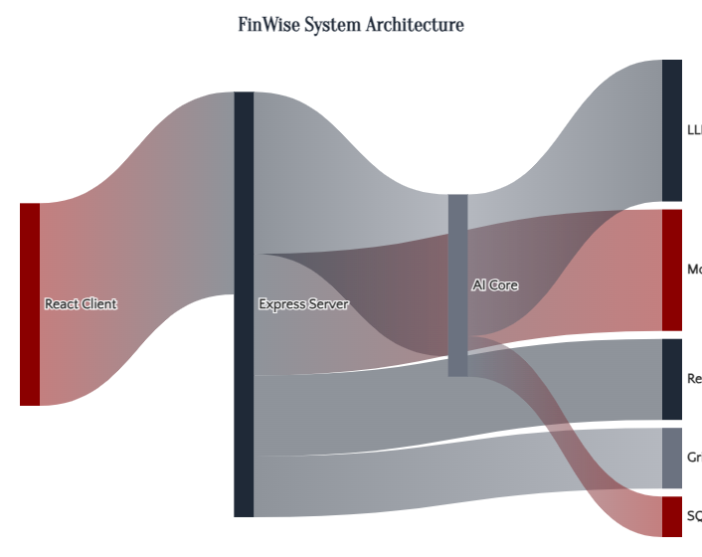
2.1 SYSTEM ARCHITECTURE
Three-Tier Architecture
Client Tier
React 18 + Vite + TypeScript
34 pages with PWA support
React Query + Zustand state
Tailwind CSS + Radix UI
Server Tier
Express 5 + Node.js + TypeScript
100+ REST API endpoints
49 Mongoose models
BullMQ background workers
AI Core Tier
Python 3.11+ + FastAPI + LangGraph
6 specialized AI agents
Multi-provider LLM failover
OCR + Vision pipeline

Slide 6
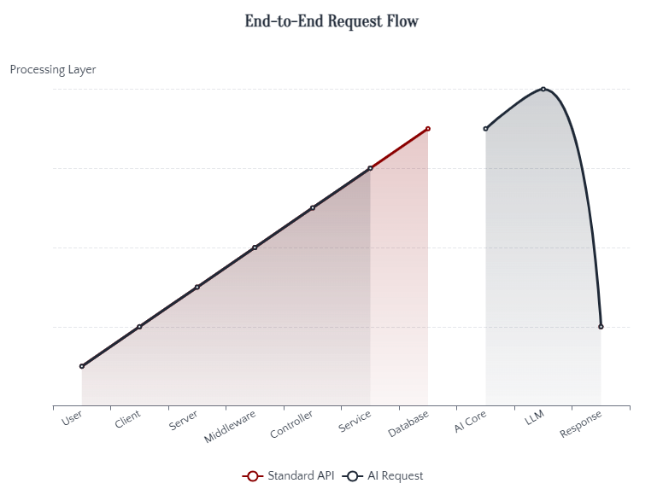
2.2 DATA FLOW
Request Lifecycle & Data Flow
Standard API Request
Client issues HTTP request via React Query
Express Router matches path through middleware stack
Controller orchestrates response, calls services
Services interact with MongoDB, Redis, or AI Core
Response flows back with React Query caching
AI Request Flow
Client sends request to /api/v1/ai/stream
Server's aiCoreClient loads context, files
Request forwarded to Python AI Core at port 8001
LangGraph workflow routes to specialist agents
Master synthesis combines outputs, streams response
Key Design Decisions
Monorepo-style for unified development
Zustand over Redux for minimal boilerplate
LangGraph for modular, testable reasoning

Slide 7
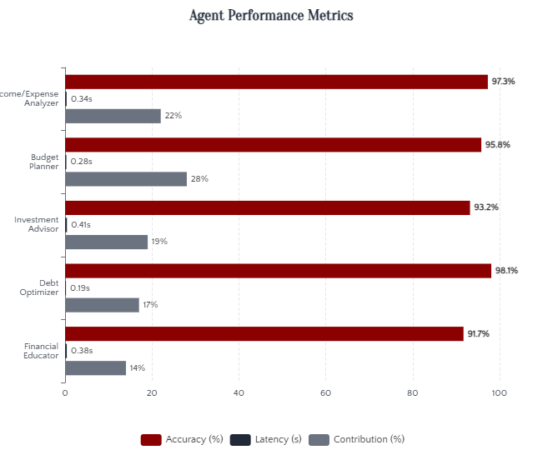
3.1 AI CORE ARCHITECTURE
Hierarchical Multi-Agent Design
Master Orchestrator
Central coordination point that decomposes queries, delegates to specialists, validates constraints, and synthesizes final responses.
6
1.23s
Specialist Agents
Avg Response
Income/Expense Analyzer
97.3%
Transaction patterns, spending trends, savings rates
0.34s
22% contrib
Budget Planner
95.8%
50/30/20 rule, zero-based budgeting, optimizations
0.28s
28% contrib
Investment Advisor
93.2%
Portfolio allocation, risk analysis, rebalancing
0.41s
19% contrib
Debt Optimizer
98.1%
Avalanche vs snowball, payoff timelines, consolidation
0.19s
17% contrib

Slide 8
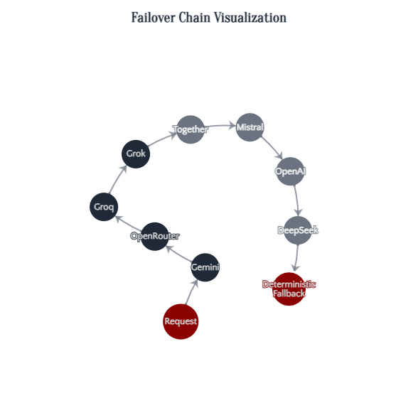
3.2 RESILIENCE ARCHITECTURE
Four-Level Provider Failover
1
Model Failover
2
Key Failover
Within same provider, try next model candidate on 404 errors
Multi-key pools with health tracking per API key
Multiple candidates per provider
Indexed keys + health scoring
3
Provider Failover
4
Deterministic Fallback
Chain across 8+ LLM vendors with priority ordering
Rule-based analysis when all LLM paths fail
100% availability guarantee
8 configured providers
Supported LLM Providers
Gemini
OpenRouter
Groq
Grok
Together
Mistral
OpenAI
DeepSeek
Model Catalog Features
100+ managed entries with capability metadata
Task-aware routing by reasoning strength, speed, cost
Health scoring with per-model latency/error tracking

Slide 9
4.1 CORE CAPABILITIES
Comprehensive Feature Set
Personal Finance Tracking
AI-Assisted Guidance
Workflow Automation
Transaction management & categorization
Multi-agent financial advisory
Scheduled tasks (cron)
Budget creation & monitoring
What-if scenario analysis
Event-driven automation
Financial goals & debt tracking
Actionable insights generation
Multi-action sequences
Analytics & visualizations
Intelligent task creation
Template-based workflows
Content Publishing
Organization Workspaces
Advanced Integrations
Blog creation & management
Multi-tenant architecture
Receipt OCR (PaddleOCR)
Growth stories sharing
Member management & invites
Handwriting recognition
Public share pages
Role-based permissions
Bank connector stubs
Media management (GridFS)
Activity feed & comments
Export (CSV, PDF)
Platform Coverage:34 pages with PWA support • 100+ API endpoints • 49 data models • 6 AI agents

Slide 10
4.2 WORKFLOW SYSTEM
Intelligent Automation
Trigger Types
Example Workflows
Manual Trigger
Weekly Bank Sync
cron
Explicitly triggered via API endpoint. No automatic scheduling.
0 9 * * 1 (Monday 9 AM)
Creates 7-day task: "Run bank sync + review spending"
Cron Trigger (Scheduled)
Uses cron-parser library. Scheduler runs every 15 seconds with timezone support.
New Transaction Review
event
Event Trigger
TransactionCreated
Responds to domain events (TransactionCreated, WorkflowDisabled, etc.)
Creates 7-day task: "Review your latest transaction"
Action Types
Queue System
ASYNC_JOBS_ENABLED
true/false
Create Task
Send Notification
Export Report
WORKER_CONCURRENCY
4 (1-64)
With idempotent SHA256 IDs
Email or in-app
CSV or PDF
POLL_INTERVAL
1000ms
Idempotency Guarantee
All actions use SHA256 hashing for idempotent IDs, preventing duplicate task creation across workflow runs.

Slide 11
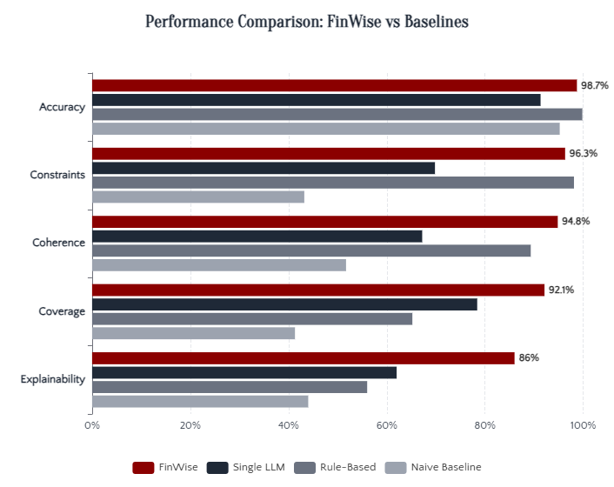
5.1 PERFORMANCE EVALUATION
Comprehensive Benchmarks
Key Performance Wins
Response Time
57% faster
1.23s vs 2.87s (Single LLM)
Constraint Satisfaction
38% better
96.3% vs 69.8% (Single LLM)
Plan Coherence
41% better
94.8% vs 67.2% (Single LLM)
Hallucination Rate
89% lower
1.2% vs 11.3% (Single LLM)
Dataset Statistics
50K
10K
Synthetic Scenarios
Real Transactions
5M
12K
Transaction Count
User Profiles

Slide 12
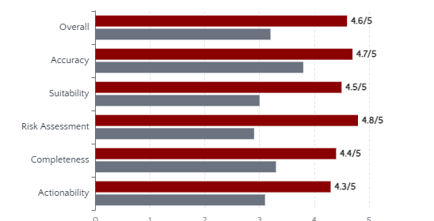
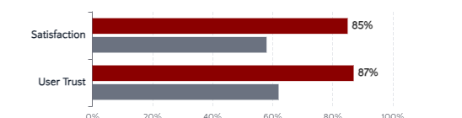
5.2 HUMAN VALIDATION
Expert & User Assessment
Expert Assessment (n=50 CFPs)
Expert Evaluation Rubric
Accuracy
4.7/5
Factual correctness, calculation precision
Weight: 30%
Suitability
4.5/5
Alignment with user profile and goals
Weight: 25%
Risk Assessment
4.8/5
Appropriate risk evaluation
Weight: 15%
Error Analysis
Arithmetic Error
1.3%
User Satisfaction (n=2,000)
Constraint Violation
3.7%
Inconsistent Advice
5.2%
Hallucination
1.2%
Key Finding
87% user trust score vs 62% for baseline systems, demonstrating significantly higher confidence in multi-agent recommendations.

Slide 13
6. TECHNOLOGY STACK
Full-Stack Implementation
Frontend
Backend
AI Core
React 18
Node.js
Python 3.11+
UI framework with hooks
Runtime environment
AI/ML runtime
TypeScript
Express 5
FastAPI
Type-safe development
Web framework
High-performance API
Vite
MongoDB
LangGraph
Build tool with HMR
Document database (49 models)
Agent orchestration
Tailwind CSS
Redis
Pydantic
Utility-first styling
Caching & queues
Data validation
React Query
BullMQ
PaddleOCR
Server-state management
Background job processing
Vision & OCR pipeline
Zustand
Passport.js
SQLite
Client-state management
Authentication middleware
AI memory storage
40+
46
24
8+
Frontend Dependencies
Backend Dependencies
Python Dependencies
LLM Providers

Slide 14
7. PRIVACY & SECURITY
Defense-in-Depth Architecture
Security Layers
Privacy-Preserving Techniques
Transport Layer
Differential Privacy
HTTPS, CORS with origin validation, trust proxy detection
Laplace mechanism for aggregate statistics with strong privacy guarantees:
M(D) = f(D) + Lap(Δf/ε)
Authentication
JWT with Passport, Google OAuth2, TOTP 2FA (RFC 6238), API key auth
Privacy parameter:
ε = 0.1
Input Validation
PII Minimization Pipeline
Zod validation on all endpoints, NoSQL injection sanitization, CSRF
Transaction data bounded by age (365 days)
Access Control
Maximum 300 transactions per request
Organization-scoped queries, role-based permissions, plugin sandbox
Only necessary fields transmitted
Regulatory Compliance
Audit & Monitoring
GDPR
CCPA
Consent Flows
Security Audit Log
26 types
Security Headers
Log Retention
365 days TTL
Helmet
CSP
Rate Limiting
Global + per-user
HSTS
X-Frame

Slide 15
8. FUTURE DIRECTIONS
Technical Enhancements & Extensions
Technical Enhancements
Domain Extensions
Advanced Orchestration
International Markets
Reinforcement learning for dynamic agent coordination based on query complexity and agent performance history.
Multi-currency support and cross-border financial planning
Specialized Advisories
Model Specialization
Tax optimization, estate planning, insurance advisory agents
Fine-tuning smaller models for specific financial tasks to reduce latency and improve domain expertise.
Behavioral Finance
Integration of psychological factors in financial recommendations
Federated Learning
Privacy-preserving model updates using decentralized user data without centralizing sensitive information.
Longitudinal Studies
Long-term impact assessment of AI-driven financial advice
Explainable AI
Enhanced explanation generation using causal reasoning frameworks for transparent recommendations.
Research Impact
These enhancements aim to establish FinWise as the gold standard for AI-driven financial advisory, with potential applications in banking, wealth management, and fintech.

Slide 16

CONCLUSION
Democratizing Financial Advisory
FinWise validates the multi-agent paradigm for complex financial advisory tasks, demonstrating that specialized, coordinated agents provide more accurate, trustworthy, and actionable guidance than monolithic approaches.
98.7%
41%
89%
2.3x
Arithmetic Accuracy
Plan Coherence
Hallucination ↓
Faster Response
vs 91.3% baseline
improvement
reduction
with superior scale
Key Achievements
4.6/5 Expert Rating
87% User Trust
From 50 certified financial advisors
From 2,000 participant study
60K Test Scenarios
GDPR/CCPA Compliant
Comprehensive evaluation dataset
Enterprise-grade privacy & security
"Establishing new benchmarks for AI-driven financial services while maintaining
the safety, privacy, and regulatory compliance essential to financial services."

